Slide 1
More on RA, RC and SQL

Slide 2
Differences between RA & RC
Relational Calculus – declarative experssion specifies what is to be retrieved rather than how to retrieve it(non-procedural language).
Relational Algebra – how to retrieve, describe a sequence of relational operations(procedural language).
* The expressive power of RA and RC is identical.

Slide 3
Two types of RC
TRC(Tuple Relational Calculus) – Variables range over tuples – SQL.
e.g. {t | COND(t) }
DRC(Domain Relational Calculus) – Variables range over single values from domains of attributes. – QBE(Query-By-Example).
e.g. {x1 ,x2 ,…,xn | COND(x1 ,x2 ,…,xn ,…, xn+m)}

Slide 4
Quantifiers in RC
Existential Quantifier (∃)
A formula (∃t)(F) is TRUE if there exists some (at least one) tuple that makes F true.
Universal Quantifier (∀)
A formula (∀t)(F) is TRUE if every possible tuple that can be assigned to t makes F true.

Slide 5
Exercise 1
Schema:
Suppliers(sid: integer, sname: string, address: string)
Parts(pid: integer, pname: string, color: string)
Catalog(sid: integer, pid: integer, cost: real)

Slide 6

Question 1
Find the names of suppliers who supply some red part.
RA
TRC
DRC

Slide 7
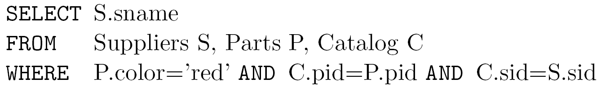
Question 1
SQL

Slide 8
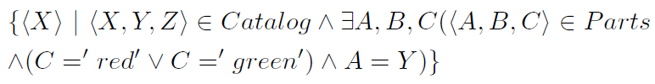
Question 2
Find the sids of suppliers who supply some red or green part.
RA
TRC
DRC

Slide 9
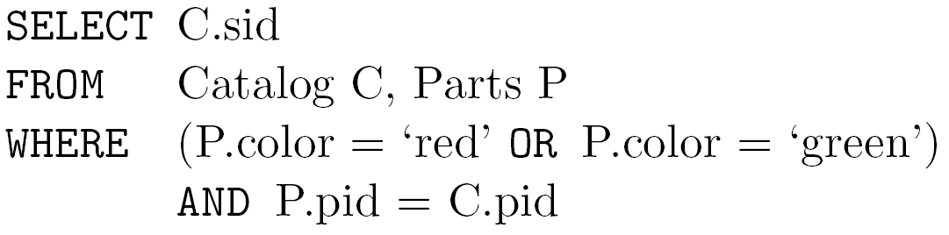
Question 2
SQL

Slide 10
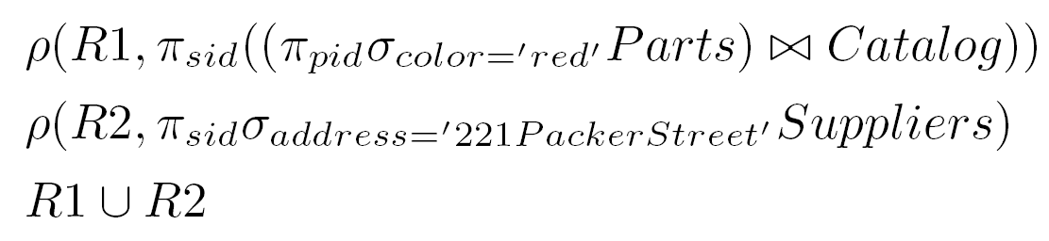
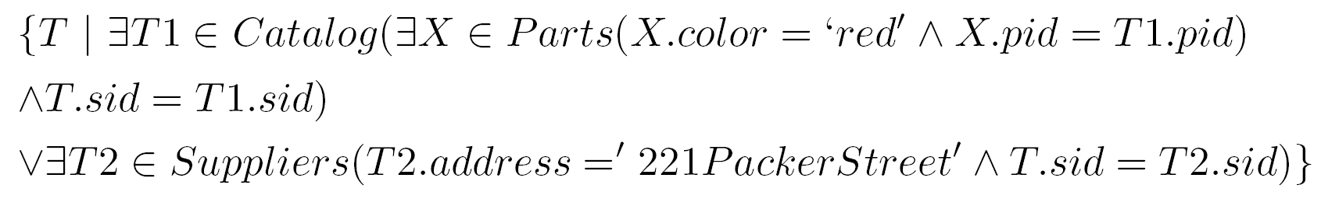
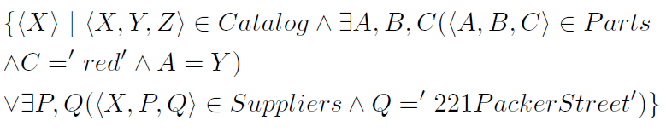
Question 3
Find the sids of suppliers who supply some red part or are at 221 Packer Street
RA
TRC
DRC

Slide 11
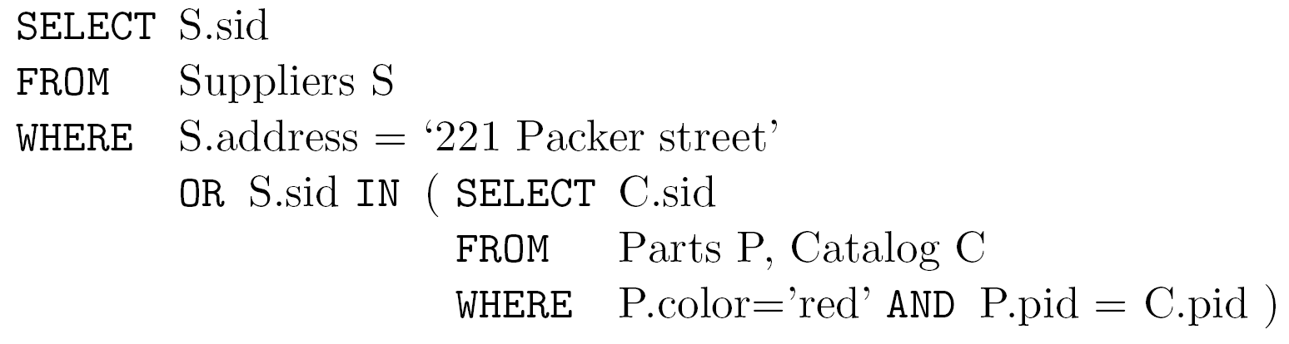
Question 3
SQL

Slide 12
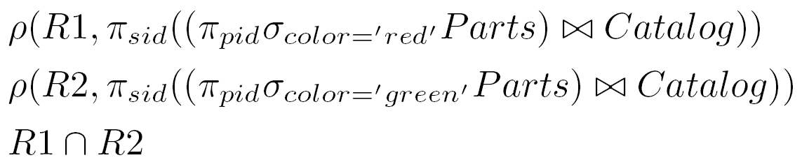
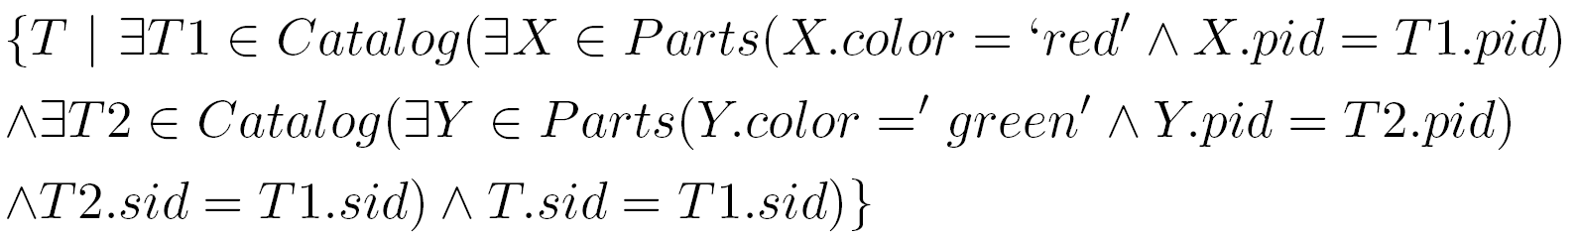
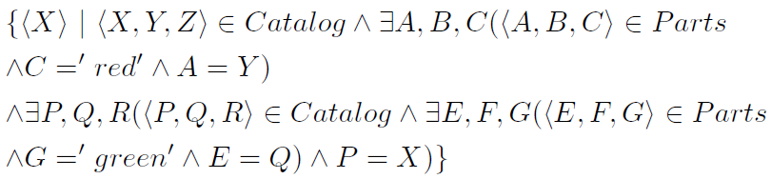
Question 4
Find the sids of suppliers who supply some red part and some green part.
RA
TRC
DRC

Slide 13
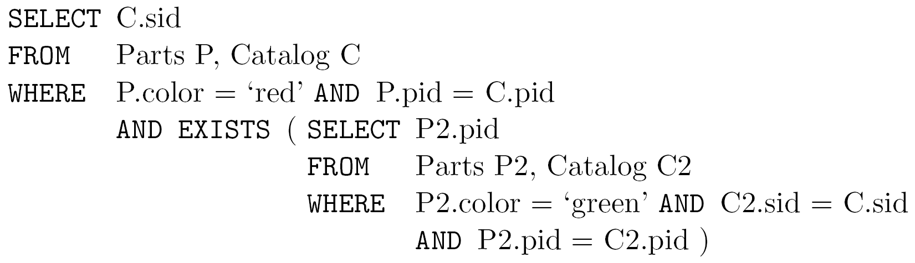
Question 4
SQL

Slide 14
Division
Consider two relations instances A and B in which A has exactly two fields x and y; and B has just one field y, with the same domain as in A.
Division’s behavior can be better understood by looking an example. See next slide

Slide 15
Division
A/B1
sno
S1
S2
S3
S4
A
sno | pno
S1 | P1
S1 | P2
S1 | P3
S1 | P4
S2 | P1
S2 | P2
S3 | P2
S4 | P2
S4 | P4
B1
pno
P2
B2
pno
P2
P4
A/B2
sno
S1
S4
B3
pno
P1
P2
P4
A/B3
sno
S1

Slide 16
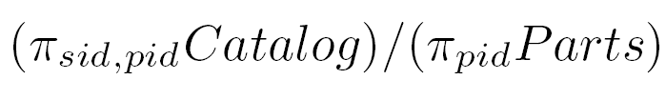
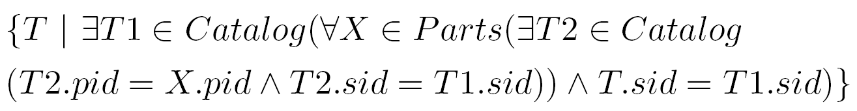
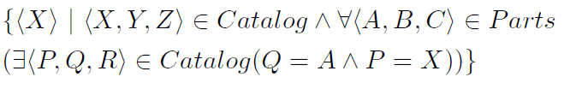
Question 5
Find the sids of suppliers who supply every part.
RA
TRC
DRC

Slide 17
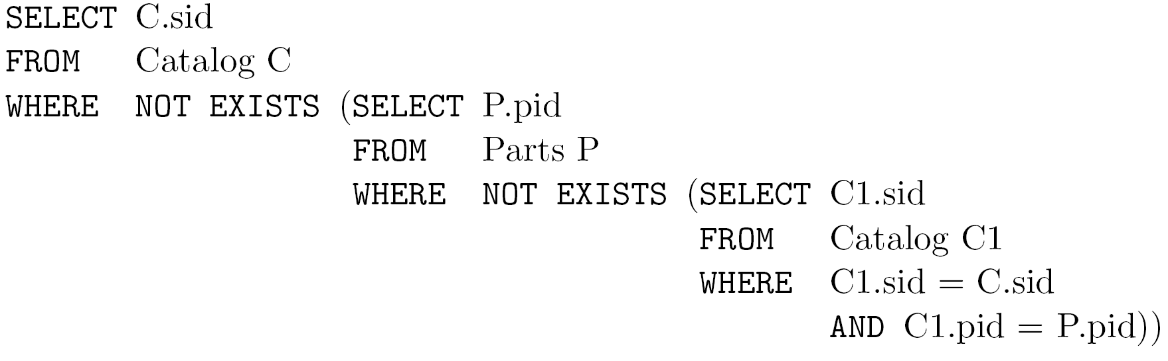
Question 5
SQL

Slide 18
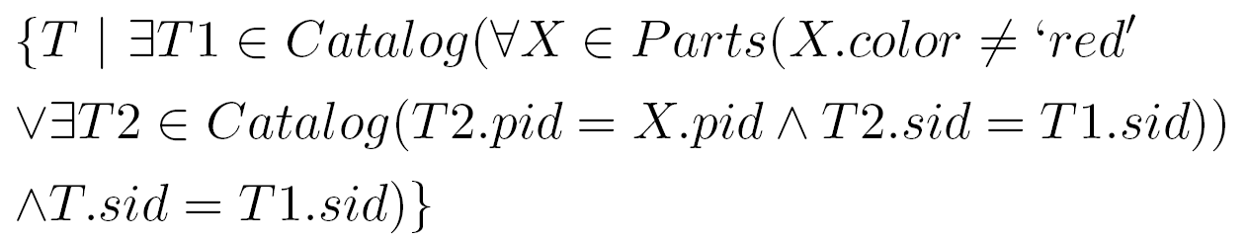
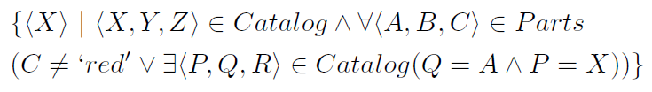
Question 6
Find the sids of suppliers who supply every red part.
RA
TRC
DRC

Slide 19
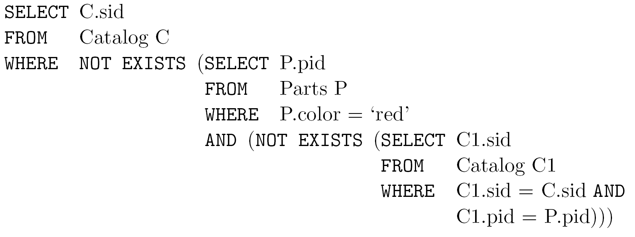
Question 6
SQL

Slide 20
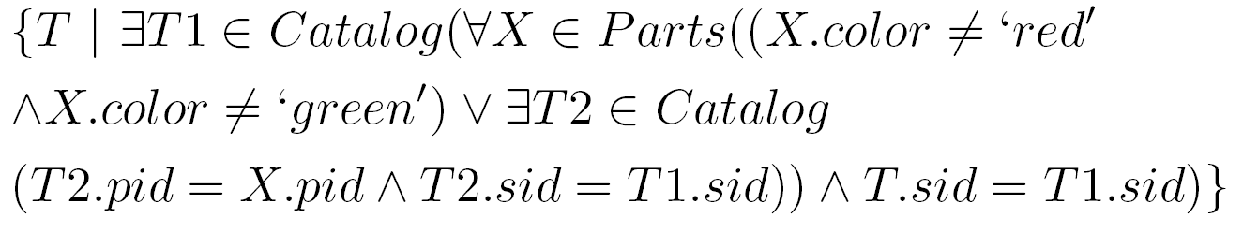
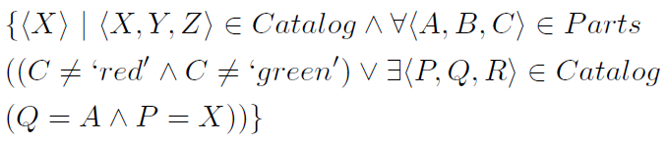
Question 7
Find the sids of suppliers who supply every red or green part.
RA
TRC
DRC

Slide 21
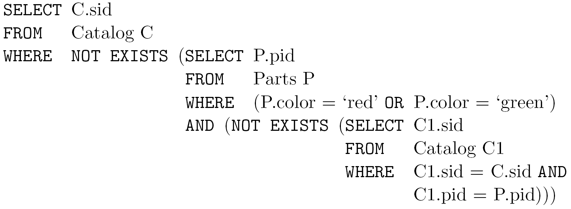
Question 7
SQL

Slide 22
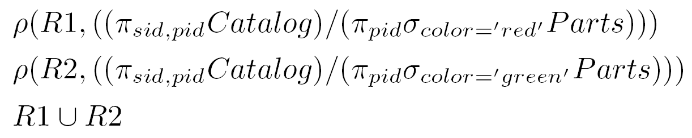
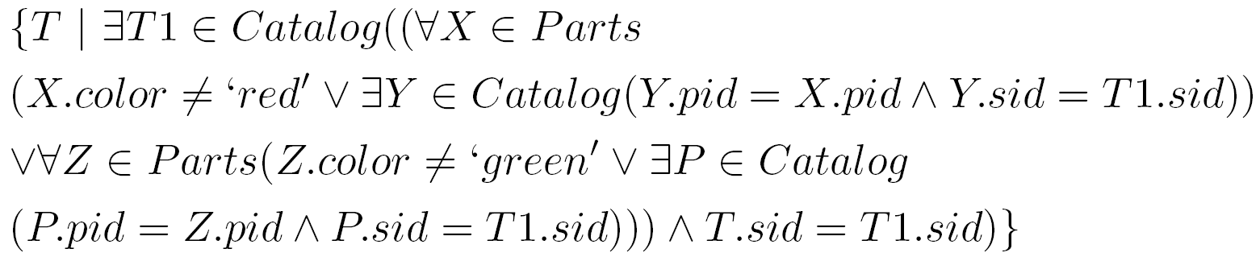
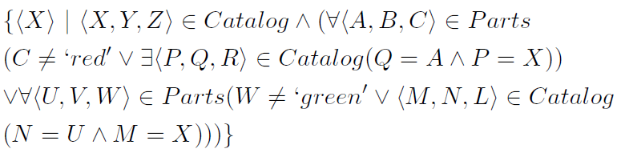
Question 8
Find the sids of suppliers who supply every red part or supply every green part
RA
TRC
DRC

Slide 23
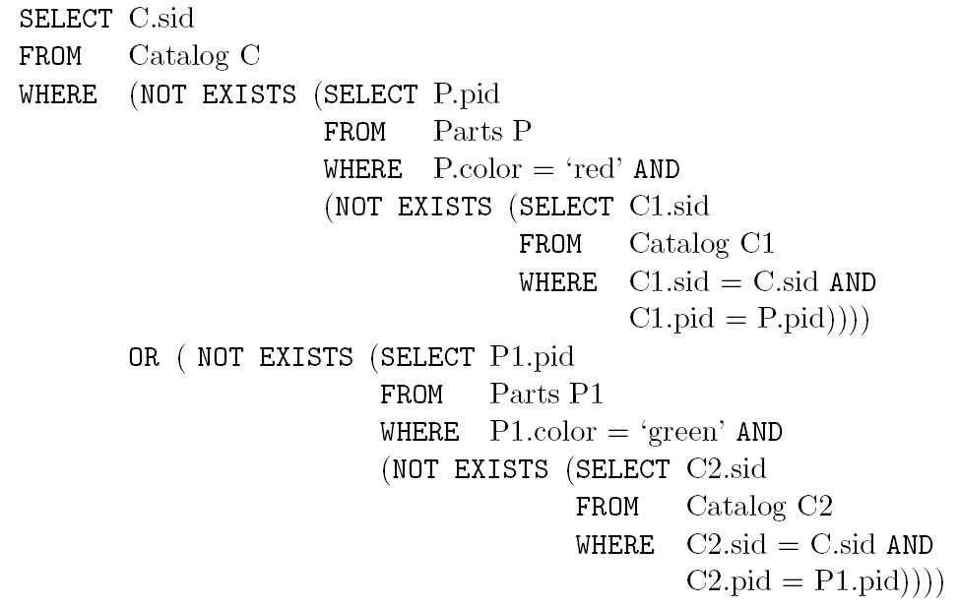
Question 8
SQL

Slide 24
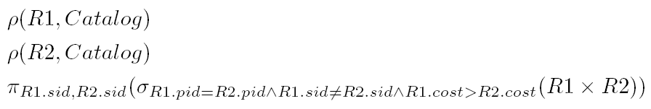
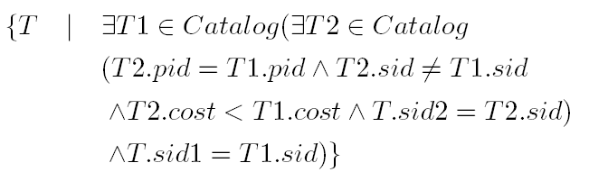
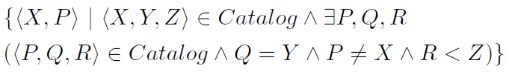
Question 9
Find pairs of sids such that the supplier with the first sid charges more for some
part than the supplier with the second sid
RA
TRC
DRC

Slide 25
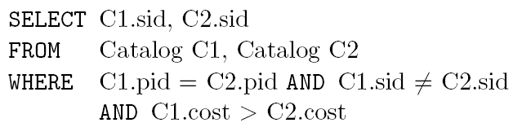
Question 9
SQL

Slide 26
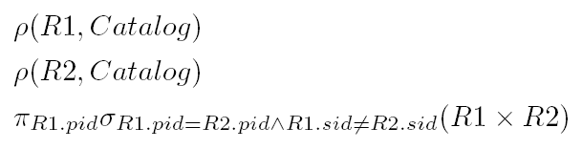
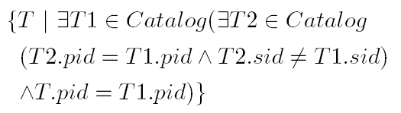

Question 10
Find the pids of parts supplied by at least two different suppliers.
RA
TRC
DRC

Slide 27
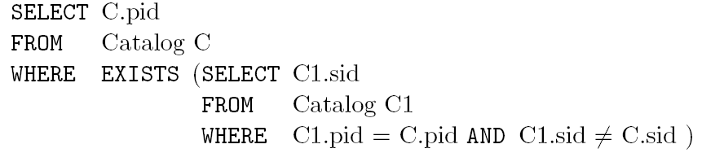
Question 10
SQL

Slide 28
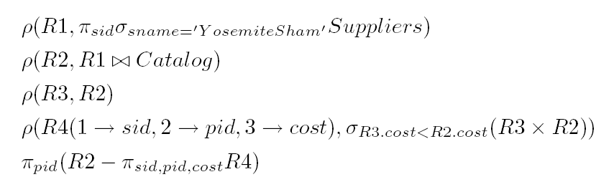
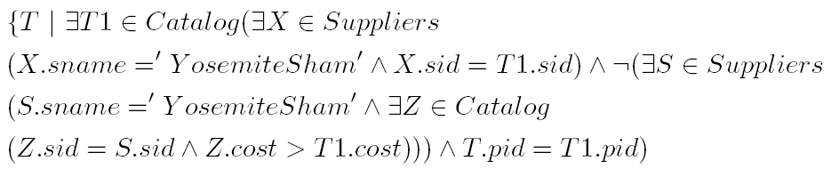
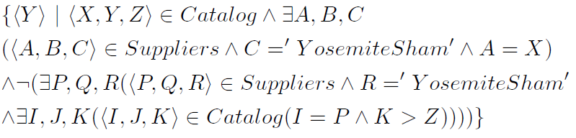
Question 11
Find the pids of the most expensive parts supplied by suppliers named Yosemite Sham
RA
TRC
DRC

Slide 29
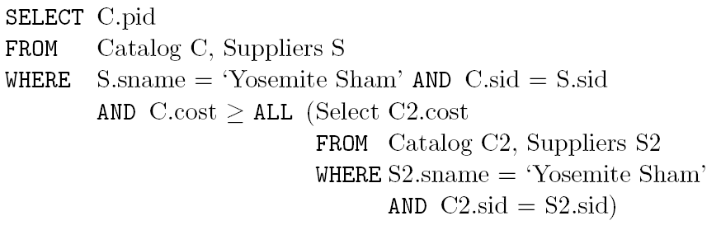
Question 11
SQL

Slide 30
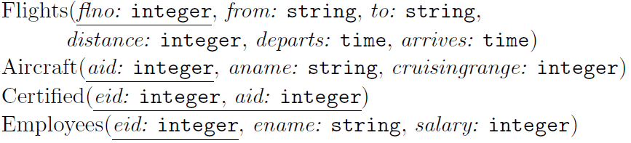
Exercise 2
Schema

Slide 31
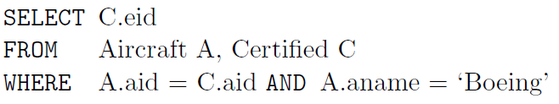
Question 1
Find the eids of pilots certified for some Boeing aircraft

Slide 32

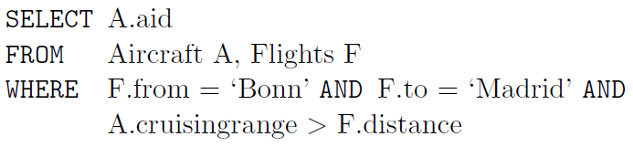
Question 2
Find the aids of all aircraft that can be used on non-stop flights from Bonn to Madras

Slide 33
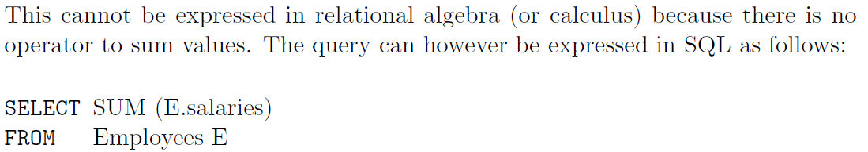
Question 3
Find the total amount paid to employees as salaries.

Slide 34
Exercise 3
Consider a relation R(A,B,C), express the FD AB-> C in relational algebra
  ^{ρ}_{R1}(A₁,B₁,C₁)(R)
  σ_{A=A1 and B=B1 and C<>C1}(R x R1)=Ø

Slide 35
Exercise 4
Consider a relation R(A,B,C), express in relational algebra that A is a key.
  ^{ρ}_{R1}(A₁,B₁,C₁)(R)
  σ_{A=A1 and B<>B1} (R x R1)=Ø
  σ_{A=A1 and C<>C1}(R x R1)=Ø

